Slide 1
Scrum Team Assignment
Eco-Fuel Factory & Sustainable Community Project

Slide 2
Team Members
• Product Owner: Sajib Das
• Scrum Master: Othoi Sadia
• Developer 1: MD. Nihon Mostari Siam
• Developer 2: Tawheed Rahman Nafee

Slide 3
Project Vision
To build an eco-fuel factory with a sustainable living community that provides housing, healthcare, and services for employees and families.

Slide 4
User Stories
1. Workers need apartments close to the factory
2. Parents need a daycare center
3. Employees want a sports center
4. Families need a grocery store
5. The company needs an eco-friendly factory

Slide 5
Product Backlog
1. Eco-fuel factory (main)
2. Employee apartments
3. Grocery store
4. Healthcare & daycare
5. Sports center
6. Community park

Slide 6
Sprint Plan
• Sprint 1: Start factory build, begin apartments, eco prototype
• Sprint 2: Finish apartments, grocery, daycare
• Sprint 3: Complete factory, healthcare, sports center, park

Slide 7
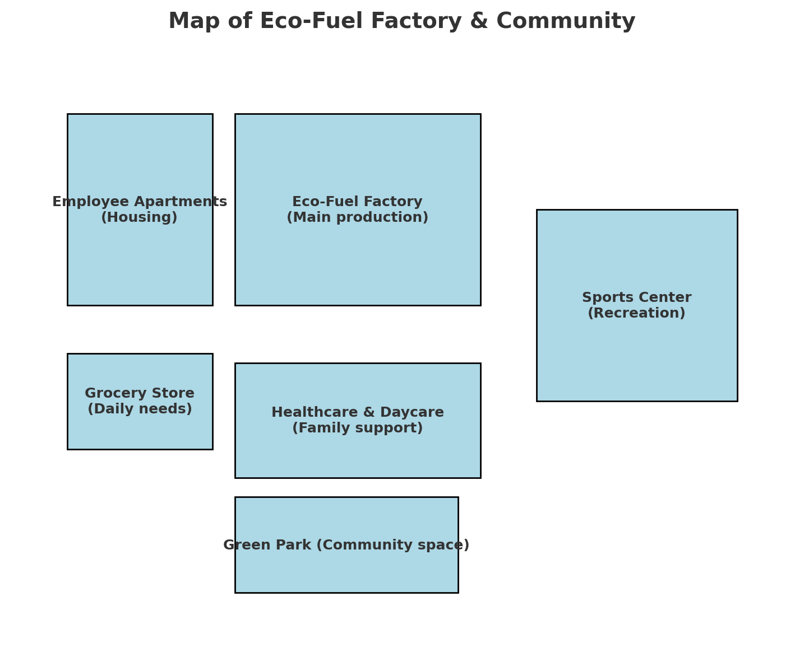
Community Map

